Slide 1

Geometry
Unit 9, Lesson 7 Volume in the Real World Volume 2, pg. 88

Slide 2


Benchmark
MA.912.GR.4.5
Solve mathematical and real-world problems involving the volume of three-dimensional figures limited to cylinders, pyramids, prisms, cones and spheres.
volume 2, pg. 88

Slide 3
Integrated Mathematical Thinking and Reasoning Standards
MA.K12.MTR.3.1 Complete tasks with mathematical fluency.
MA.K12.MTR.4.1 Engage in discussions that reflect on the mathematical thinking of self and others.
MA.K12.MTR.5.1 Use patterns and structure to help understand and connect mathematical concepts.
MA.K12.MTR.7.1 Apply mathematics to real-world contexts.
volume 2, pg. 88

Slide 4

Learning Target
I can use volume to solve problems with real-world applications.
volume 2, pg. 88

Slide 5

Warm-Up
volume 2, pg. 89

Slide 6
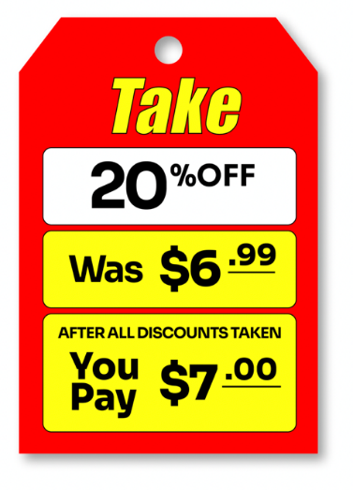
9.7.1 Warm-Up: Math Fail
The clearance sign shown is what is known as a “math fail.”
What do you notice about the sign that makes this a math fail?
Write a letter to the company explaining why this is a math fail and how to fix the issue.
volume 2, pg. 89

Slide 7

Collaboration
volume 2, pg. 89

Slide 8

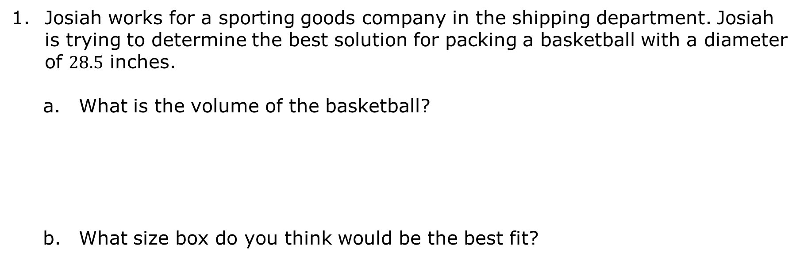
9.7.2 Collaboration: Packing Peanuts
Josiah works for a sporting goods company in the shipping department. Josiah is trying to determine the best solution for packing a basketball with a diameter of $28.5$ inches.
What is the volume of the basketball?
What size box do you think would be the best fit?
volume 2, pg. 89

Slide 9
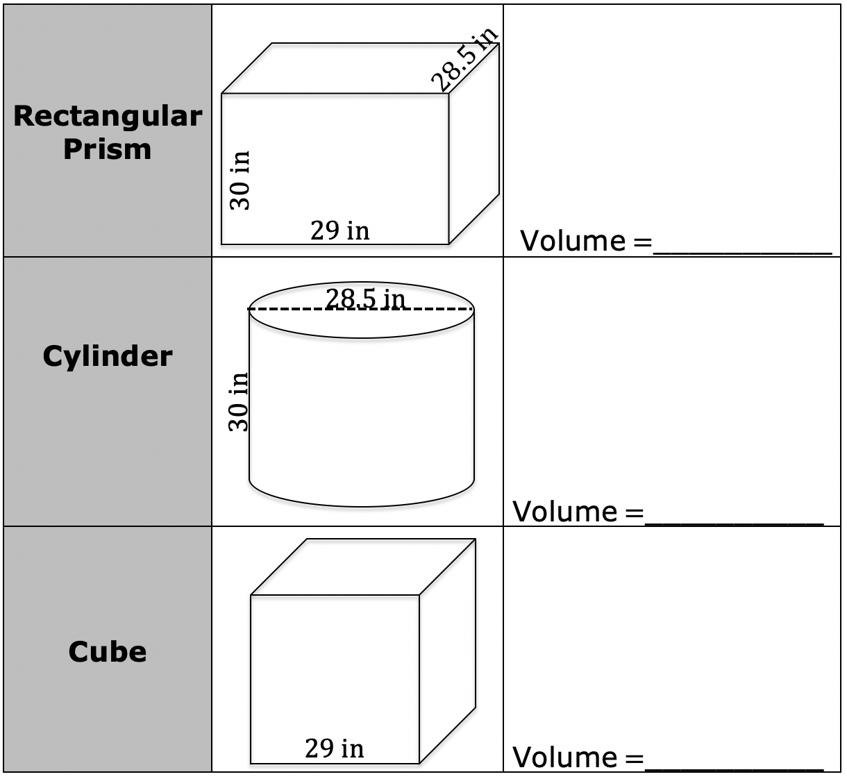
Find the volume of the three options of boxes below, from which Josiah can choose.
volume 2, pg. 89

Slide 10
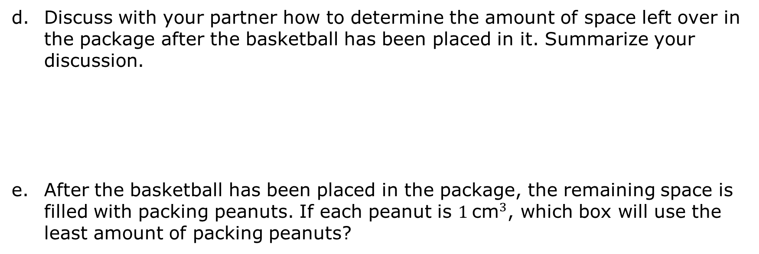
Discuss with your partner how to determine the amount of space left over in the package after the basketball has been placed in it. Summarize your discussion.
After the basketball has been placed in the package, the remaining space is filled with packing peanuts. If each peanut is $1 {\text{cm}}^{3}$, which box will use the least amount of packing peanuts?
volume 2, pg. 90

Slide 11

Guided Practice
volume 2, pg. 90

Slide 12

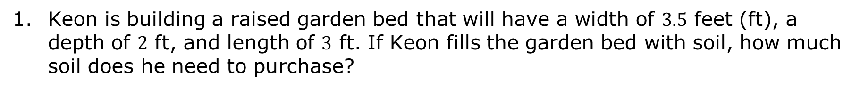
9.7.3 Guided Practice: Volume
Keon is building a raised garden bed that will have a width of $3.5$ feet (ft), a depth of $2$ ft, and length of $3$ ft. If Keon fills the garden bed with soil, how much soil does he need to purchase?
volume 2, pg. 90

Slide 13
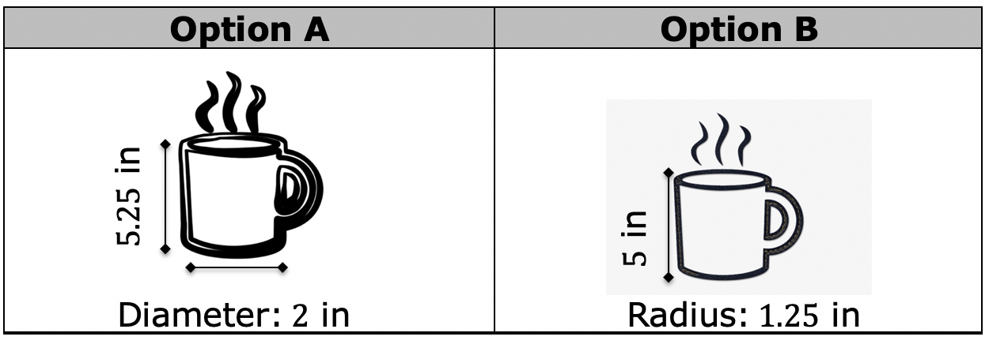
Jasper wants to buy a new coffee mug, and he has narrowed it down to two options. The dimensions are given in inches (in.)
What is the volume, rounded to the thousandths place, of option A?
What is the volume, rounded to the thousandths place, of option B?
volume 2, pg. 90

Slide 14

Your Turn
volume 2, pg. 91

Slide 15
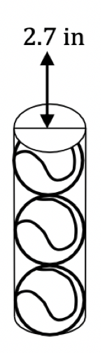
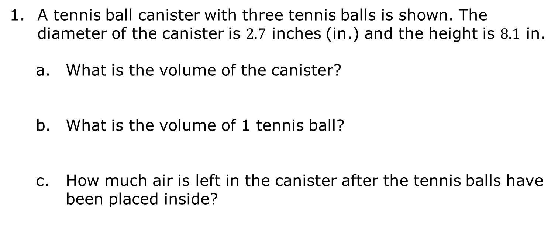
9.7.4 Your Turn!
A tennis ball canister with three tennis balls is shown. The diameter of the canister is $2.7$ inches (in.) and the height is $8.1$ in.
What is the volume of the canister?
What is the volume of 1 tennis ball?
How much air is left in the canister after the tennis balls have been placed inside?
volume 2, pg. 91

Slide 16
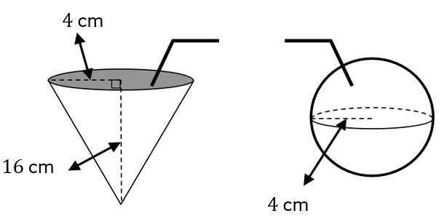
Club Cool in Epcot offers free samples of Coke products that are distributed worldwide. Flavors include Fanta Pineapple, Fanta Melon, Inca Cola, VegitaBeta, and Sparberry. You can choose to have your sample served in either of the below containers shown.
volume 2, pg. 91

Slide 17
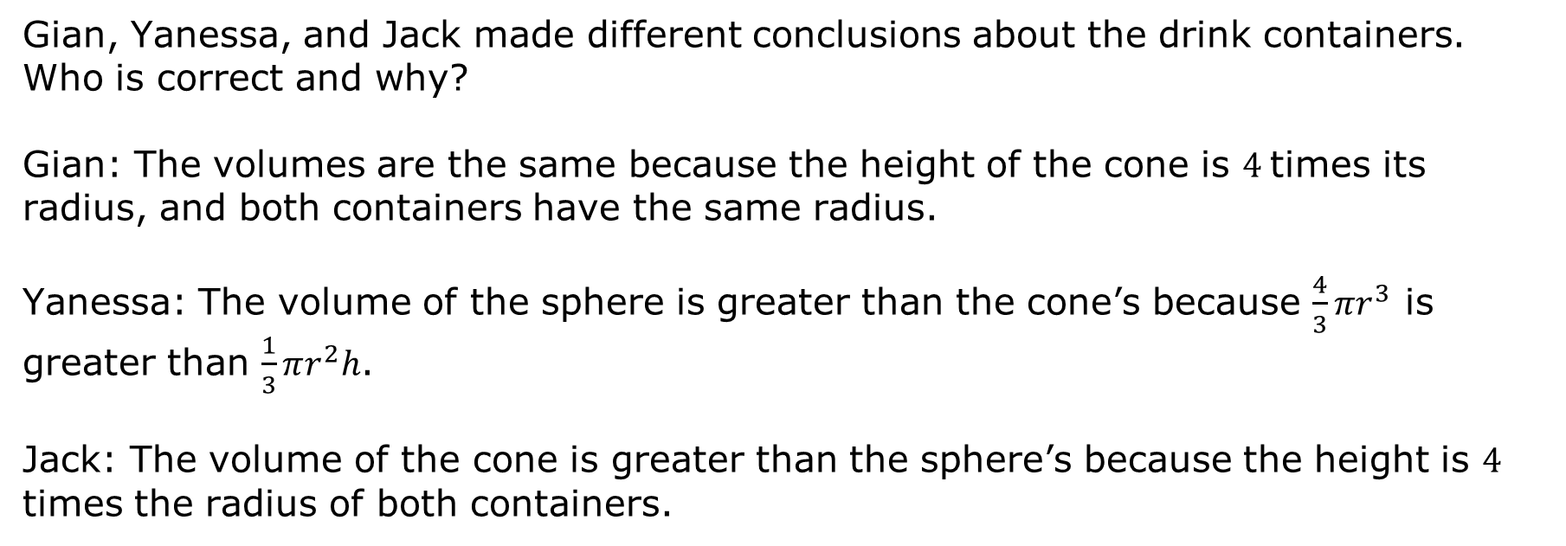
Gian, Yanessa, and Jack made different conclusions about the drink containers. Who is correct and why?
Gian: The volumes are the same because the height of the cone is $4$times its radius, and both containers have the same radius.
Yanessa: The volume of the sphere is greater than the cone’s because $\frac{4}{3}πr^{3}$ is greater than $\frac{1}{3}πr^{2}h$.
Jack: The volume of the cone is greater than the sphere’s because the height is $4$ times the radius of both containers.
volume 2, pg. 91

Slide 18
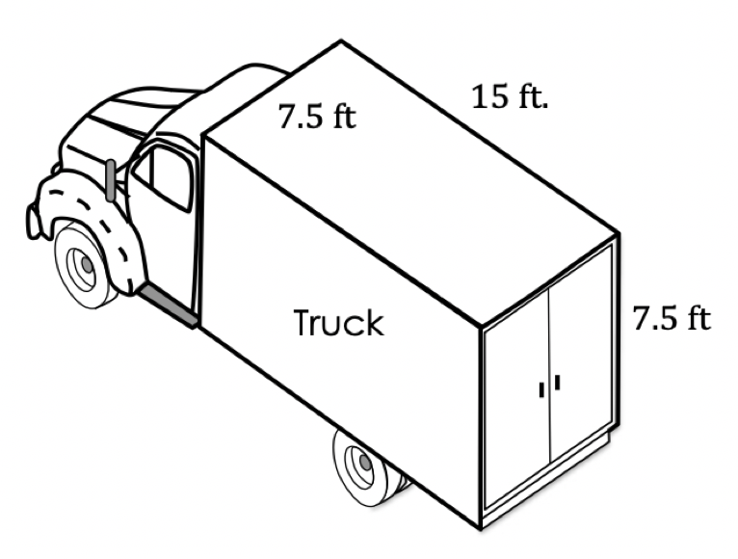

Julian owns a moving company and has a truck that measures $15 \text{ft} × 7.5 \text{ft} × 7.5 \text{ft}$.
He charges individuals by the number of boxes in the moving truck. If each box is a cube with side lengths of $1.5 \text{ft}$, how many boxes can he fit in the truck?
volume 2, pg. 92

Slide 19
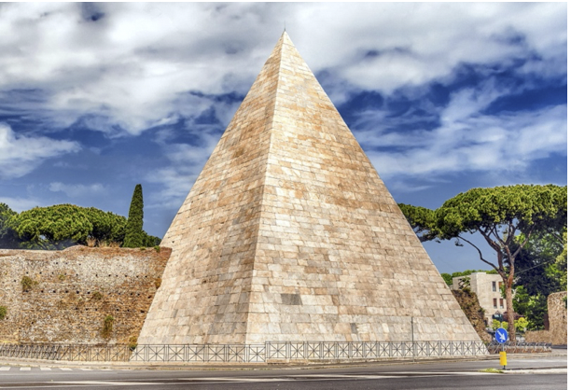
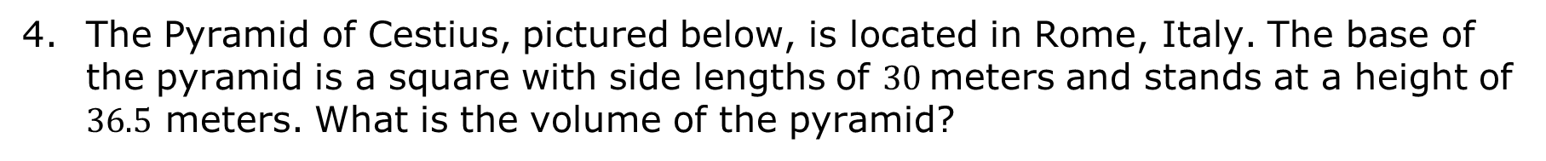
The Pyramid of Cestius, pictured below, is located in Rome, Italy. The base of the pyramid is a square with side lengths of $30$meters and stands at a height of $36.5$ meters. What is the volume of the pyramid?
volume 2, pg. 92

Slide 20

Wrap-Up
volume 2, pg. 93

Slide 21
9.7.5 Wrap-Up: Cool Down
Provide a real-world context that would require you to find the volume of a three-dimensional figure.
volume 2, pg. 93

